Slide 1

Saturday, January 22, 2022
What is Geography?
Do Now: What is name of the website created for this class?
Longitude- angular distance east or west on the earth's surface, measured by the angle contained between the meridian of a particular
Latitude- the angular distance of a place north or south of the earth's equator, or of the equator of a celestial object, usually expressed in degrees and minutes.
Objective: Understand the focus of geography and the two main branches of the discipline.
Learn about the tools geographers use to study the earth’s surface.
Summarize the grid system of latitude and longitude and how it relates to seasons and time zones.
Notes:
1

Slide 2

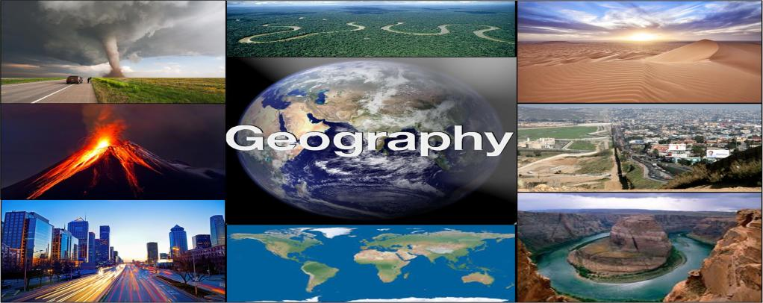

Geography Basics
What is Geography?!
Geography is the spatial study of the earth’s surface (from the Greek geo, which means “Earth,” and graphein, which means “to write”).
Thinking like a geographer helps us understand the beauty and complexity of the world. A geographer looks at space and place.
Geographers study where people live, why they live there, and how they interact with each other and the land on which they live.

Slide 3


Geography Basics
What are the different types of Geography?
Physical Geography- is the spatial study of natural phenomena that make up the environment, such as rivers, mountains, landforms, weather, climate, soils, plants, and any other physical aspects of the earth’s surface.
Cultural Geography- Human geography is the study of human activity and its relationship to the earth’s surface. Human geographers examine the spatial distribution of human populations, religions, languages, ethnicities, political systems, economics, urban dynamics, and other components of human activity.
Physical Geography | Cultural Geography
Rocks/Minerals | Population/Settlements/Urbanization
Landforms | Economic and Political Systems
Animal and Plant Life | Transportation
Soils | Human Migration
Atmosphere/Climate/Weather | Social Systems
Environment | Recreation
Rivers/Oceans/Other bodies of Water | Religion/Belief System

Slide 4
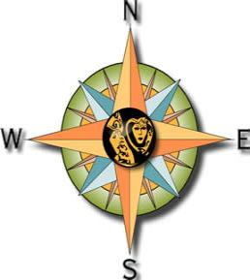
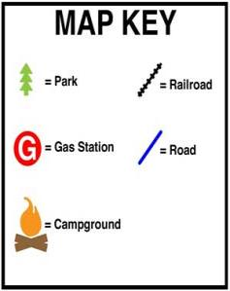
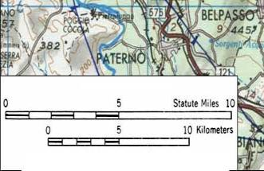

Geography Basics
Using Maps
Cartography is the science of making maps.
There are many components to a map, including a title, a legend, symbols, and color-coding.
Scale represents the consistent, proportional relationship between the measurements shown on a map and on Earth’s surface.
Physical, political, and thematic maps each serve a unique purpose and show different types of information.

Slide 5
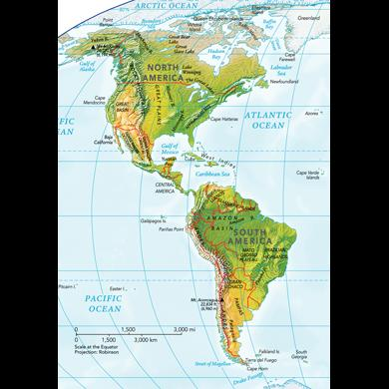
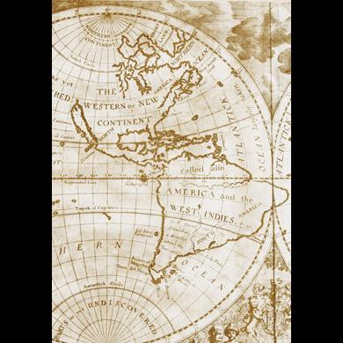
Interactive #1

Slide 6
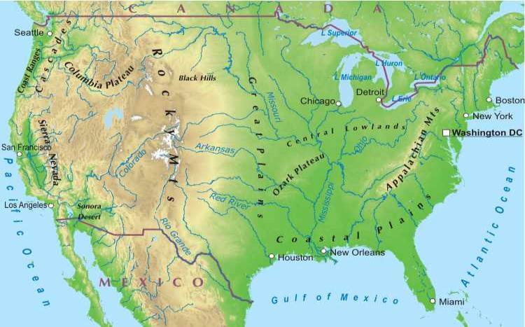
Geography Basics
Physical Maps
Show natural features such as landforms and physical borders; lakes, rivers, mountain ranges, and things that were around before humans
Physical Borders – Borders defined by a physical feature
Example - Rio Grande River, between USA and Mexico

Slide 7
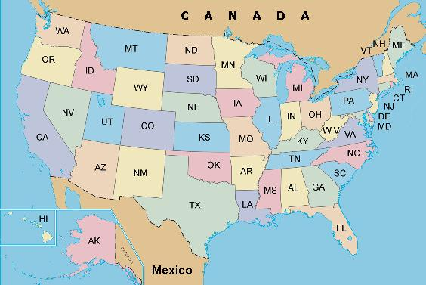
Geography Basics
Political Maps
Show features on the Earth’s surface that are manmade.
Examples: Political Borders – borders created by governments
National and State Borders,
City Limits, capitals

Slide 8
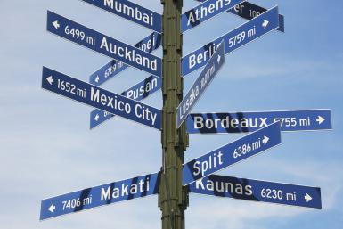
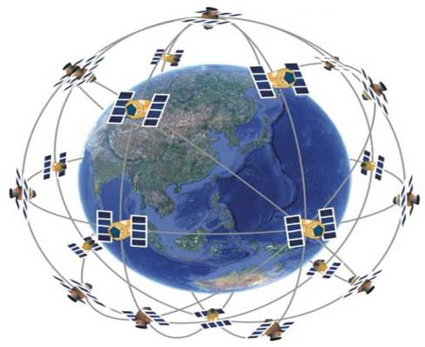
Geography Basics
The Earth and Graticule Location
When identifying a region or location on the earth, the first step is to understand its relative and absolute locations.
The absolute location of a place is the point at which its latitude and longitude lines intersect.
Relative location- is the location on the earth’s surface with reference to other places, taking into consideration features such as transportation access or terrain.

Slide 9

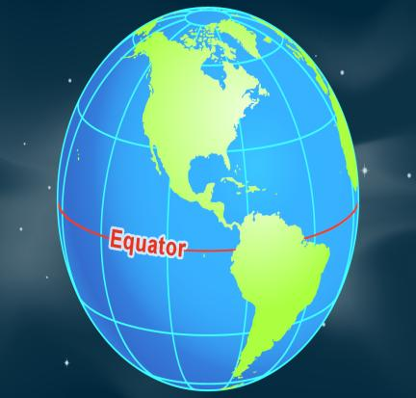
Geography Basics
Parallel or Lines of Latitude
The Equator divides Earth in half, creating the Northern and Southern Hemispheres.
The equator divides the earth into the Northern and Southern Hemispheres and is called 0 degrees latitude.
The lines north of the equator toward the North Pole are north latitude, (shortcut—think of FLATITUDE) and each of the numbers is followed by the letter “N.” (Vice-versa for south latitude or “S”)

Slide 10
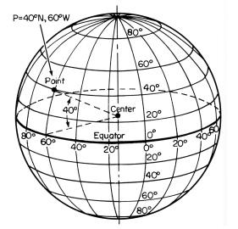
Geography Basics
Absolute Location is determined by using lines of latitude and longitude to form a grid.

Slide 11
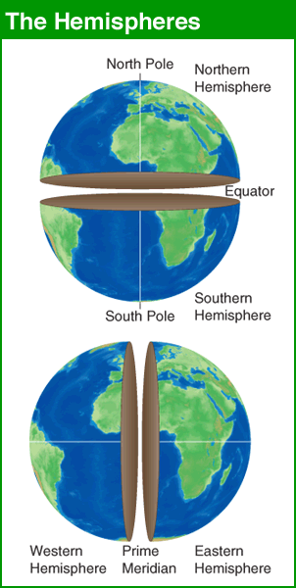
Interactive #2

Slide 12
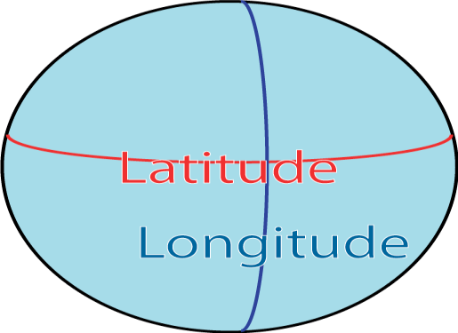
Geography Basics
Meridians or Lines of Longitude
The prime meridian sits at 0 degrees longitude and divides the earth into the Eastern and Western Hemispheres.
The prime meridian is defined as an imaginary line that runs through the Royal Observatory in Greenwich, England, a suburb of London.
All meridians (lines of longitude) east of the prime meridian (0 and 180) are numbered from 1 to 180 degrees east (E); Vice versa for west (W).

Slide 13
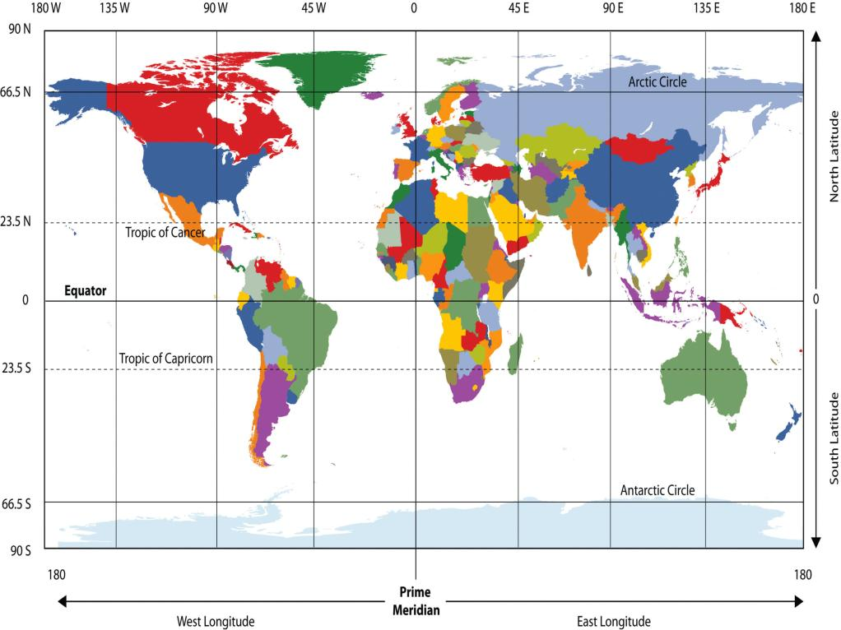

Slide 14
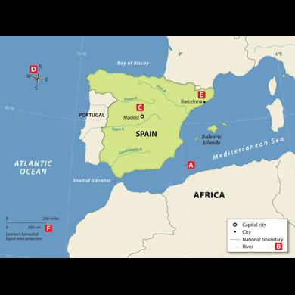
Interactive #3

Slide 15
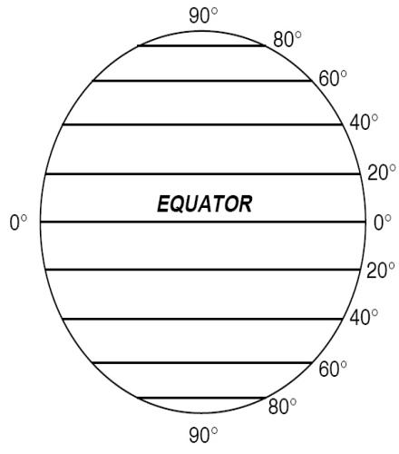
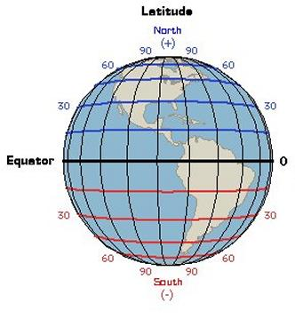
Geography Basics
Latitude – parallels of latitude measure distance north or south from the equator
Equator – an imaginary line that circles the earth at its widest point - 0°

Slide 16
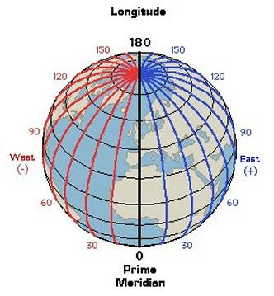
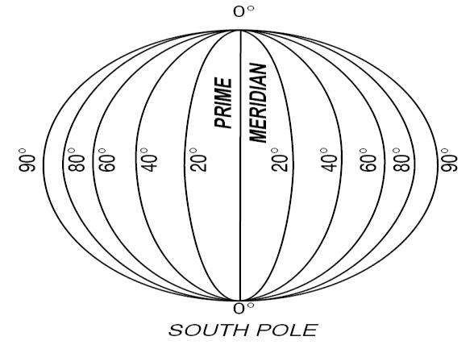
Geography Basics
Longitude – meridians measure distance east or west from the Prime Meridian.
Prime Meridian – line of longitude that runs through Greenwich, England - 0°

